Slide 1
Acts Chapter One
40 Days, Ascension, End Times

Slide 2
40 Days
Mark 1:13 And he was in the wilderness forty days, being tempted by Satan. And he was with the wild animals, and the angels were ministering to him.
Acts 1:3 He presented himself alive to them after his suffering by many infallible proofs, appearing to them during forty days and speaking about the kingdom of God.
The first 40 days led “into” the earthly ministry of Jesus , the last 40 days led “out of” the earthly ministry of Jesus.
“speaking about the Kingdom of God” – we have no record of this teaching, private for the apostles, for that time in history

Slide 3
40 Days - Symbolism
40 days = transition time, establishing a new spiritual condition, judgment, cleansing etc
Noah’s Flood – 40 days to wipe out human sin and eventually bring in Abrahamic faith
The embalming of Joseph – transition into the heavenly (Genesis 50:3)
Moses on the mountain getting the ten commandments, twice (Exodus 24:18, 34:28)
The spies were in Canaan 40 days (Numbers 13:25) results in 40 yrs punishment (Numbers 14:34)
Goliath challenged Israel for 40 days (1 Sam 17:16)
Elijah’s 40 days on Mt Horeb living on angel food
Ezekiel on his side 40 days symbolic for 40 years punishment (Ezekiel 4:6 )
Jonah 40 days to overthrow Nineveh (Jonah 3:4)
If 40 days = 40 years then also 40 years from Ascension to destruction of Jerusalem.

Slide 4
Ascension
In order to “fill all things”: Eph 4:10
Ascended into a “place” Jn 14:2-3
Above the heavens – Eph 1:20-21
Taken up in glory: 1 Tim 3:16, Heb 1:4; Rev 5:12; Jn 17:5
God’s Right Hand: Ps. 110:1; Heb 1:3; 1 Peter 3:22, Acts 2:33; 7:56;
Ascended in a bodily way out of their sight: Acts 1:9-11
Ascends until He returns! (Ps. 110)
Spoils the principalities and powers : Eph 4 and Col 2
Authority to wrestle with them: Eph 6:12; 2 Cor 10:4
No longer under the “stoichea” Col 2:8-23, Gal 4:1-10

Slide 5
We Are Now Citizens of Heaven
Heavenly Zion: Heb 12:18ff
Citizens of Heaven: Eph 2:19; Phil 3:20; Heb 11:10,16
Seated in Heavenly Realms : Eph 2:6
Life Hidden With Christ In God: Col 3:1-4; 1 Jn 3:1-4
Greater Than OT Saints: Matt 11:11-13

Slide 6
Outpouring Of The Spirit
(John 14:12 NKJV) "Most assuredly, I say to you, he who believes in Me, the works that I do he will do also; and greater works than these he will do, because I go to My Father.
(John 16:7 NRSV) Nevertheless I tell you the truth: it is to your advantage that I go away, for if I do not go away, the Advocate will not come to you; but if I go, I will send him to you.
(Acts 1:4-5 NKJV) And being assembled together with them, He commanded them not to depart from Jerusalem, but to wait for the Promise of the Father, "which," He said, "you have heard from Me; {5}"for John truly baptized with water, but you shall be baptized with the Holy Spirit not many days from now."
(Acts 2:31-33 NRSV) Foreseeing this, David spoke of the resurrection of the Messiah, saying, 'He was not abandoned to Hades, nor did his flesh experience corruption.' {32} This Jesus God raised up, and of that all of us are witnesses. {33} Being therefore exalted at the right hand of God, and having received from the Father the promise of the Holy Spirit, he has poured out this that you both see and hear.
(Acts 11:15-16 NKJV) "And as I began to speak, the Holy Spirit fell upon them, as upon us at the beginning. {16} "Then I remembered the word of the Lord, how He said, 'John indeed baptized with water, but you shall be baptized with the Holy Spirit.'

Slide 7
Authority
Authority – (Gk. “exousia’)
Positional authority, command authority, the legitimate right to exercise power, privilege, mastery, magisterial power, the power of a potentate.
Christian authority is always ‘in the name of the Lord Jesus Christ - and is not our own authority to wield as we like. It must do God’s will.
(Matthew 7:29, 8:8-13, Luke 9:1,2; 10:17-19, John 1:12, Acts 26:18, Ephesians 1:20,21; Revelation 2:26,27; 6:8, 9:3,4; 11:6)

Slide 8
Power
Power - (Gk. ‘dunamis’)
the ability to do something or to make something possible.
Miraculous power, God’s power,
A mighty work, ability, abundance, power, strength.
(Matthew 17:20, 19:26, Mark 9:23, Luke 1:37, Matthew 11:21, 14:1,2; 22:29, 24:29,30; 26:64; Mark 5:30, 9:1,39; Luke 1:7, 4:6,36; 6:19, Acts 1:8)

Slide 9
Energies
Energies (Gk. ‘energeia)
energies that work in or through a person (sometimes used in combination w. dunamis)
resurrection power,
including divine or demonic energies , occult energy, spiritual gifts, influences, demonstrations of power,
(Ephesians 1:19,20; 2:2, 2 Thessalonians 2:7, 9; 1 Corinthians 12:6,11; 16:9, Mark 6:14, Galatians 2:8, 3:5; Ephesians 3:7, 4:16, Philippians 3:21, Colossians 1:29, 2:12, Hebrews 4:12)

Slide 10
AUTHORITY
POWER
ENERGIES

Slide 11
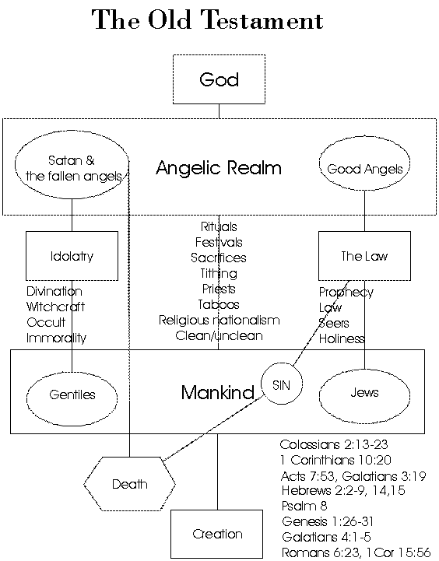

Slide 12
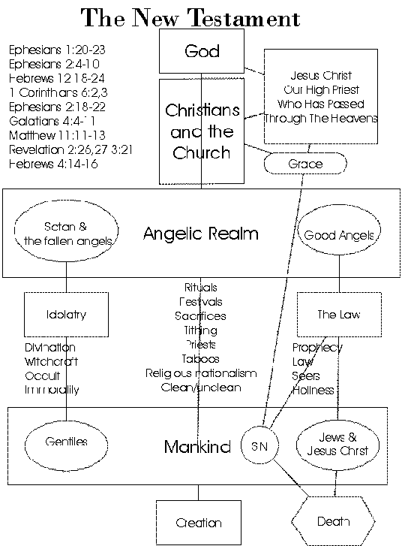

Slide 13
The Heavenly Realms
Above the Heavens - God – A Place of Great Glory
3rd Heaven – The Throne of God
Satan was cast out of the Third Heaven, was in the 2nd Heaven before the cross. After being defeated by Christ he is now ‘prince of the power of the air (1st heaven)
2nd Heaven – Angels / Spiritual Warfare
1st heaven - Air
Satan will be cast to the Earth and this will bring about the Tribulation, he will then end up in the Pit and later in the Lake of Fire
Earth
Abraham’s Bosom (Good)
Sheol
Hades – Bad ?Torment
At the cross Sheol was emptied of the good . And the bad area Hades became Hell
Hades /Hell
The Pit
The Lake Of Fire

Slide 14
The Three Heavens
The word Heaven is plural “shamayim” or “ouranoi” (Gk). There are three heavens or “shamayim” mentioned in Scripture.
Above the Heavens – where God’s glory dwells and where Satan once aimed to be. (Psalm 8:1, 108:4,5, Ephesians 1:20, 4:10, Isaiah 14:12-14)
Third Heaven (2 Corinthians 12:2) – the Throne, where Paul went and heard holy things.
Second Heaven (Revelation 12:4-12, 14:6,7) –Where Satan and fallen angels first fell to and demons are fighting for now.
First Heaven (Genesis 1:20, Psalm 104:12, Daniel 2:38) – birds dwell, Satan dwells as prince of the power of the air since the cross.

Slide 15
The Lower Realms
Earth esp. “The Face Of The Earth” (Genesis 6:1, Acts 17:26Job 1:7,2:2, 1 Peter 5:8) – the place of human habitation, also where Satan prowls, and will be cast down to in the end times.
Hades/ The Grave/Under The Earth /In The Sea/The Deep (Genesis 1:2, Exodus 20:4, Deuteronomy 5:8, Job 28:14, Philippians 2:10, Revelation 5:3) – the place human bodies, human souls before the cross, and the strange creatures of the deep dwell. In 1 Samuel 28:15 the prophet is “brought up” by the witch of Endor. Presently where the souls of the disgraced dead dwell. n Matthew 27:52,53 there is a partial resurrection of the righteous OT saints “from the graves”.
Abyss/the Bottomless Pit/(Isaiah 14:11-15; Numbers 16:33, Ezekiel 32:15-18 Luke 8:31, 10:7, Revelation 9:1,2; 20:1-3) – where confined demons dwell
The Lake of Fire (Revelation 19;20, 20:10-15) – a future place of eternal punishment prepared for the Devil and his angels and those who accept the mark of the Beast.

Slide 16
End Times Confusion - 1
Then, indeed, these coming together, they asked Him, saying, Lord, do You at this time restore the kingdom to Israel? And He said to them, It is not for you to know the times or the seasons, which the Father has put in His own authority. (Acts 1:6-7)
The heaven and the earth shall pass away, but My Words shall not pass away. (36) But of that day and hour no one knows, no, not the angels of Heaven, but only My Father.
(Matthew 24:35-36)

Slide 17
End Times Confusion - 2
God Limits Our Knowledge By His Sovereign Will
We Don't Have The Whole Picture
God's Idea Of Time Is Nothing Like Our Idea Of Time
The Cannot Be Understood By The Fallen Human “Carnal” Mind
Prophecy Generally Only Becomes Clear When The Reality That It Refers To Appears On The Scene of History
God Generally Only Reveals To a Person What They Are To Do Next Or The Meaning Of The Thing They Are Personally Called To Do

Slide 18
The Spirit Removes Shame
Then, indeed, these coming together, they asked Him, saying, Lord, do You at this time restore the kingdom to Israel? ….But you shall receive power, the Holy Spirit coming upon you. And you shall be witnesses to Me both in Jerusalem and in all Judea, and in Samaria, and to the end of the earth.
(Acts 1:6-8 MKJV)
The disciples wanted their national and ethnic shame removed.
Jesus answers with the baptism of the Spirit which would take the message of One God and of Christ to the ends of the world, via the apostles. A better answer.

Slide 19
The Law of Compensation
And he cried and said, Father Abraham, have mercy on me and send Lazarus so that he may dip the tip of his finger in water and cool my tongue, for I am tormented in this flame. But Abraham said, Son, remember that you in your lifetime received your good things, and likewise Lazarus evil things. But now he is comforted and you are tormented.
(Luke 16:24-25 )
The Universe always strives for balance.
The natural is compensated in the spiritual
Hundredfold return in the Millennium for those who sacrificed for the gospel.
And everyone who left houses, or brothers, or sisters, or father, or mother, or wife, or children, or lands, for My name's sake, shall receive a hundredfold, and shall inherit everlasting life. But many who are first shall be last; and the last shall be first. (Matthew 19:29-30 MKJV)

Slide 20
Shame Now, Glory Later
And if we are children, then we are heirs; heirs of God and joint-heirs with Christ; so that if we suffer with Him, we may also be glorified together. For I reckon that the sufferings of this present time are not worthy to be compared with the coming glory to be revealed in us. (Romans 8:17-18)
The apostolic sufferings would result in apostolic glory.
Their personal frustration at not having the earthly kingdom and thrones would result in a heavenly Kingdom and thrones.
Jesus crucifixion resulted in His glorious ascension and every knee bowing to Him (Philippians 2:5-11)

Slide 21
Balance Restored..
The who hunger and thirst after righteousness are filled (Matthew 5:6)
The poor receive the Kingdom (Matthew 5:3)
Those who mourn are comforted (Matthew 5:4)
The meek inherit the earth (Matthew 5:5)
Abraham has to leave his family to become the Father of many nations (Genesis 12:1-3)
We have to die to receive new life
(Matthew 10:39, John 11:25)
Those who are crucified to the world will reign and rule with Christ (Galatians 6:14, 2 Timothy (2:12)
The humble are exalted (Luke 14:11, James 4:6,10)
The martyrs receive crowns of life (Revelation 2:10)
Those who refuse the Mark of the Beast and thus cannot buy or sell will receive eternal life and eternal reward (Revelation 14:12,13; 20:6)
Those who accept the Mark to gain earthly comfort will receive eternal torment. (Revelation 14:9-11)

Slide 22
Two Baptisms
For John truly baptized with water, but you shall be baptized in the Holy Spirit not many days from now. (Acts 1:5)
Baptism = immersion
Baptism in water for repentance
Baptism in the Holy Spirit for power in life and ministry.
Disciples were baptized in water under John the Baptist and in the Spirit at Pentecost.
Samaritans baptized in water by Phillip later in the Spirit by the apostles. Similarly with 12 men at Ephesus.
(Acts 8:14-17, 10:44-48, 19:1-7))

Slide 23
Jesus The Spirit Baptizer
I indeed baptize you with water to repentance. But He who comes after me is mightier than I, whose sandals I am not worthy to carry. He shall baptize you with the Holy Spirit and with fire; (Matthew 3:11)
And John bore record, saying, I saw the Spirit descending from Heaven like a dove, and He abode on Him. And I did not know Him, but He who sent me to baptize with water, that One said to me, Upon whom you shall see the Spirit descending, and remaining upon Him, He is the One who baptizes with the Holy Spirit. (John 1:32-33)
God raised up this Jesus, of which we all are witnesses. Therefore being exalted to the right of God, and having received from the Father the promise of the Holy Spirit, He has poured out this which you now see and hear. (Acts 2:32-33 )

Slide 24
Gift Activation
The Holy Spirit baptizes us “into the body of Christ” and activates and empowers our spiritual gifts of service.
See 1 Corinthians 12:13 in the context of the whole chapter (which is on the use of spiritual gifts).
The baptism of the Holy Spirit, is the Spirit “upon” us, which is the power and anointing and gift activating function of the Holy Spirit.
Therefore I remind you to inflame anew the gift of God, which is in you by the putting on of my hands. (2 Timothy 1:6)

Slide 25
Baptism Into Diversity
Many gifts, one Holy Spirit
Many manifestations, one Holy Spirit
Jews, Greeks, slave, free, male, female: one Holy Spirit
Creation is diverse, many species, many colors, brought into being through the Holy Spirit who hovered over the waters.
Too much uniformity (e.g cults) is not from the Holy Spirit.
We do not all have to be teachers or evangelists or prophets.
Its Ok to be a leader, administrator, healer, have a gift of mercy etc.
The Holy Spirit empowers ALL of the gifts, not just the miracle gifts or up-front gifts.

Slide 26
Judas
Of the twelve: Matthew 10:4
A devil (John 6:70,71)
A thief (John 12:5,6)
Objected to generosity toward Jesus/ anointing
(John 12:1-8)
Reacted to this by betraying Jesus for money: (Matthew 26:14,15; Mark 14:10,11; Luke 22:3-6)
Was exposed by Jesus (John 13:21-30)
Betrays Jesus with a kiss (Matthew 26:47-50)
Son of perdition (John 17:12) like the Anti-Christ in the Last Days (2 Thessalonians 2:3, Revelation 17:8,11))
Fulfills prophecies: (Zechariah 11:12-14, Ps 69.)
Commits suicide: Matthew 27:3-10, Acts 1:18
Baptized, taught by Jesus, saw miracles , in ministry and even did miracles when the 12 were sent out but was a Devil and was LOST! (John 17:12)

Slide 27
Sons of the Devil
Matthew 13:38 - the “tares”
Acts 13:10 – an occult magician
John 8:44 – the Pharisees who opposed Jesus
Matthew 23:15 – the Pharisees and their converts “children of Hell”
1 John 2:22 – those who deny the Father and the Son
1 John 3:8 – those who willingly and willfully practice sin
1 John 3:10 – those not practicing righteousness and/or not living in love.
Judas sinned even around the anointing of Jesus (by being a thief) so he became fully demonic and a son of the Devil.

Slide 28
Falling Away
It is the Spirit that makes alive, the flesh profits nothing. The words that I speak to you are spirit and are life. But there are some of you who do not believe. For Jesus knew from the beginning who they were who did not believe, and who is the one betraying Him. And He said, Because of this I said to you that no one can come to Me unless it was given to him from My Father. From this time many of His disciples went back into the things behind, and walked no more with Him. (john 6:66) Then Jesus said to the Twelve, Do you also wish to go away? Then Simon Peter answered Him, Lord, to whom shall we go? You have the Words of eternal life. (John 6:63-68 MKJV)

