Slide 1
How The Denominations Came About

Slide 2
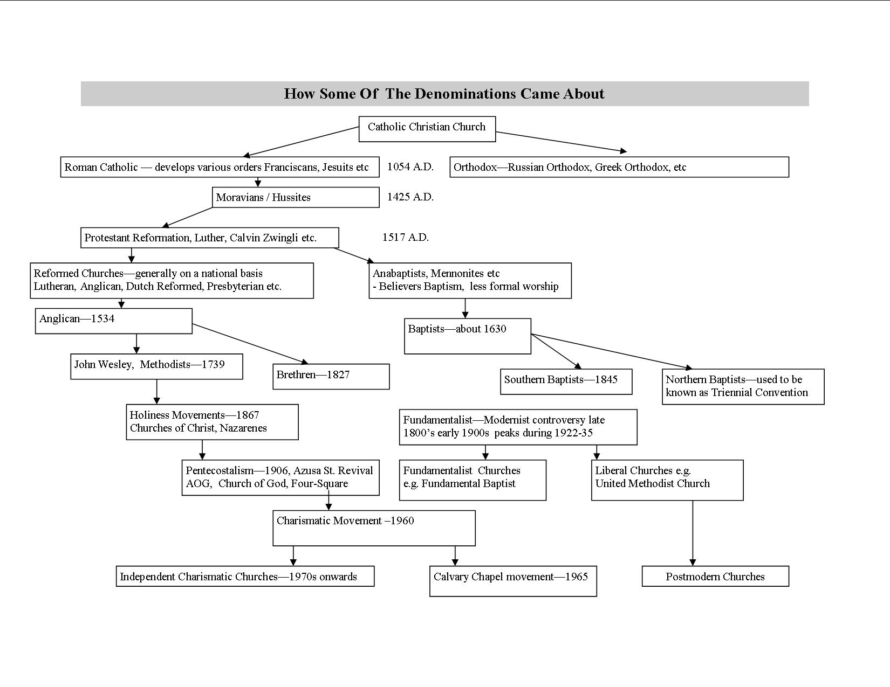

Slide 3
The Roman Catholic – Orthodox Split
Tensions built between the Eastern & Western sections of the Roman Empire for centuries over questions of theology, church structure and administration and the role of the Bishop of Rome.
1014 AD the Roman Catholic Church (known then as the Western or Roman Church) added the words ‘and the Son’ to the Nicene Creed (in the section about the Holy Spirit, without consulting the Eastern Church (Bishop of Constantinople).
In 1054 AD the two main Bishops (Rome and Constantinople) excommunicated each other

Slide 4
Why Such Splits Occur
Regional and cultural differences
Political differences
The perceived need for reform (the church is seen to be dead spiritually or corrupt morally or both)
Theological differences, heresies, sects, cults
Differences in church structure
Differences in church practice
Differences in liturgy
Power struggles between clergy
Financial mismanagement / poor leadership
Decolonization / emerging leaders in Asia, Africa etc

Slide 5
Garden Beds
Generally one side of the split continues on as before, largely unchanged while the other side of the split eventually fragments further into other denominations and becomes a ‘garden bed’
Catholic – Anglican – Methodist –Holiness Movements –Pentecostalism-Charismatic churches (on diagram)

Slide 6
The Role Of The Bible
Sometimes the Church drifts away from the Bible or the Bible is taught in a language that people cannot understand
Instead of the Bible people rely on rituals and customs and sometimes even on myths, legends and superstitions
Without the Bible people demand strong central leaders
Then the Bible is rediscovered, translated and taught and there is a spiritual revival and many of the old (unbiblical) customs are thrown out
People ‘think for themselves’ and come to their own conclusions and need less direct leadership from above
Often the spiritual revival is resisted by the older leaders

Slide 7
The Role Of New Leaders
From time to time new spiritual leaders come along who have strong personalities and deep spiritual insights
These leaders tend to form new church orders, new missionary societies, new local churches and even whole new denominations
Sometimes power struggles or doctrinal debates result
These leaders must be evaluated by the fruit of their lives, their character, their ministry and their teaching Matthew 7:15-23

